Slide 1

Geometry Class Library
Descriptions of the “PathGeom” class of functions

Slide 2

Many applications require a reference path
For example, roads are a form of path. The task of driving is to stay on the road, which means that a vehicle’s position relative to the path must be measured.

Slide 3
Definitions of terms are important so that we don’t get confused later
Station
Stations
Path
Paths
Traversal
Traversals

Slide 4
For many examples below, MATLAB code will be given. It is usually highlighted as shown here: yellow for scripts, grey for console outputs.
%% Example 1: simple three points
fig_num = 1;
x = [-4; -2; 1];
y = [0; -4; -1];
apex_points = [x y];
fcn_FastestTraversal_calculateObstacleDirectionAtApexPoints(...
apex_points, fig_num);
>> script_test_fcn_geometry_selfCrossProduct
cross_products =
0
err =
1

Slide 5
Each function uses a secondary argument check function
function fcn_geometry_checkInputsToFunctions(...
variable,variable_type_string,varargin)
% fcn_geometry_checkInputsToFunctions
% Checks the variable types commonly used in the geometry codes to
% ensure they are correctly formed.
%
% This function is typically called at the top of most functions. The input
% is a variable and a string defining the "type" of the variable. This
% function checks to see that they are compatible. For example, say there
% 'column_vector' type of variables used in the function that is always a N
% x 1 array; if someone had a variable called "test_example", they could
% check that this fit the 'column_vector' type by calling
% fcn_geometry_checkInputsToFunctions(test_example,'column_vector').
% This function would then check that the array was N x 1, and if it was
% not, it would send out an error warning.
See: script_test_fcn_geometry_checkInputsToFunctions.m for example usages

Slide 6
To fit a line, one can use the point-slope fitting function: fcn_geometry_fitSlopeInterceptNPoints
NOTE: it cannot fit vertical lines correctly
slope = -3;
intercept = 4;
Npoints = 1000;
x_data = linspace(-2,5,Npoints)';
y_data = x_data*slope + intercept + intercept*0.2*randn(Npoints,1);
points = [x_data,y_data];
[slope,intercept] = fcn_geometry_fitSlopeInterceptNPoints(points,fig_num);

Slide 7
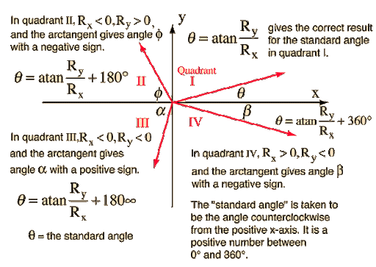
Generally, the functions used for path planning avoid calculation of angles using inverse tangents. Instead, we use dot and cross products
The main problem with using absolute angles instead of relative angles is that there will be discontinuities in angles between quadrants

Slide 8
The self cross-product operation is available to determine which direction a path is bending, to the right or to the left
%% BASIC example - find the cross-products for positive bend
fig_num = 1;
path = [0 0; 1 1; 0 2];
[cross_products] = ...
fcn_geometry_selfCrossProduct(...
path, fig_num) %#ok<*NOPTS,*NASGU>
%% BASIC example - find all the cross-products for negative bend
fig_num = 2;
path = [0 0; 1 1; 2 0];
[cross_products] = ...
fcn_geometry_selfCrossProduct(...
path, fig_num) %#ok<*NASGU>

Slide 9
It requires that paths have bends at each apex, e.g. that the lines are not straight or go straight backward at any point
%% BASIC example -
% find all the cross-products for many bends
fig_num = 3;
path = [0 0; 1 1; 0 2; 2 4; 4 2; 6 2; 2 7];
[cross_products] = ...
fcn_geometry_selfCrossProduct(...
path, fig_num)

Slide 10
If they are straight or backward, an error is returned as 1 in the argument
%% ERROR example - find cross product for bent back on self
fig_num = 5;
path = [0 0; 1 1; 0 0];
[cross_products,err] = ...
fcn_geometry_selfCrossProduct(...
path, fig_num) %#ok<*NASGU>
cross_products =
0
err =
1

Slide 11
The script to plot circles is: fcn_geometry_plotCircle
%% BASIC example for one circle
fig_num = 1;
figure(fig_num); axis square; grid minor;
center = [1,3];
radius = [2];
fcn_geometry_plotCircle(center,radii,fig_num);
%% BASIC example for multiple circles
fig_num = 2;
figure(fig_num); axis square; grid minor;
centers = [1 3; 2 4];
radii = [2; 3];
fcn_geometry_plotCircle(centers,radii,fig_num);

Slide 12
Derivation notes for fcn_geometry_circleCenterFrom3Points
By S. Brennan, sbrennan@psu.edu , 2020_05_22

Slide 13
Our goal is to find the circle that fits within three given points
Given: (x1, y1), (x2,y2), (x3,y3)
Find: (xc,yc) – the center of a circle passing through all 3 points, and r, the radius of that circle (not required, but helpful).

Slide 14
The solution approach is based on the equation for a circle
Since
$$(x−x_{c})^{2}+(y−y_{c})^{2}=r^{2}$$
So:
$$x^{2}−2⋅x⋅x_{c}+x_{c}^{2}+y^{2}−2⋅y⋅y_{c}+y_{c}^{2}+=r^{2}$$
Which, if x and y are known, is 1 equation with 3 unknowns (xc, yc, r)

Slide 15
We rearrange this to try to get a linear form
$$x^{2}−2⋅x⋅x_{c}+x_{c}^{2}+y^{2}−2⋅y⋅y_{c}+y_{c}^{2}+=r^{2}$$
Becomes:
$$x_{c}^{2}+y_{c}^{2}−r^{2}=2⋅x⋅x_{c}+2⋅y⋅y_{c}−(x^{2}+y^{2})$$
For the first point:
$$x_{c}^{2}+y_{c}^{2}−r^{2}=2⋅x_{1}⋅x_{c}+2⋅y_{1}⋅y_{c}−(x_{1}^{2}+y_{1}^{2})$$
Let $r_{01}^{2}$ be the radial distance from the origen to point 1. Then:
$$x_{c}^{2}+y_{c}^{2}−r^{2}=2⋅x_{1}⋅x_{c}+2⋅y_{1}⋅y_{c}−r_{01}^{2}$$

Slide 16
So for points 2 and 3:
$$2⋅x_{2}⋅x_{c}+2⋅y_{2}⋅y_{c}−r_{02}^{2}=2⋅x_{1}⋅x_{c}+2⋅y_{1}⋅y_{c}−r_{01}^{2}$$
Or:
$$2⋅{(x}_{2}−x_{1})⋅x_{c}+2⋅(y_{2}−y_{1}) =r_{02}^{2}−r_{01}^{2}$$
And similarly:
$$2⋅{(x}_{3}−x_{2})⋅x_{c}+2⋅(y_{3}−y_{2}) =r_{03}^{2}−r_{01}^{2}$$

Slide 17
This admits a matrix form:
$$2⋅{(x}_{2}−x_{1})⋅x_{c}+2⋅(y_{2}−y_{1}) =r_{02}^{2}−r_{01}^{2}$$
$$2⋅{(x}_{3}−x_{2})⋅x_{c}+2⋅(y_{3}−y_{2}) =r_{03}^{2}−r_{01}^{2}$$
Becomes:
$$\left[\begin{matrix}{(x}_{2}−x_{1}) & (y_{2}−y_{1}) \\ {(x}_{3}−x_{2}) & (y_{3}−y_{2})\end{matrix}\right]\left[\begin{matrix}x_{c} \\ y_{c}\end{matrix}\right]=\frac{1}{2}\left[\begin{matrix}r_{02}^{2}−r_{01}^{2} \\ r_{03}^{2}−r_{01}^{2}\end{matrix}\right]$$
Which has the form of a regression equation:
$$A\left[\begin{matrix}x_{c} \\ y_{c}\end{matrix}\right]=b⇒\left[\begin{matrix}x_{c} \\ y_{c}\end{matrix}\right]=A^{−1}⋅b$$

Slide 18
The solution to this is solved via the MATLAB code:
num_solutions = length(points(:,1))-2; % This is the number of solutions to expect
r_squared = sum(points.^2,2); % These are the radii-squared of points from origin
diff_points = diff(points);
diff_x = diff_points(:,1);
diff_y = diff_points(:,2);
diff_rsquared = diff(r_squared);
Set up vectors:
Solve the problem:
if 1 == num_solutions % Expecting just one solution. No need for big A, b matrices
% solve for the center point
A = [diff_x diff_y];
b = 1/2*diff_rsquared;
else % Simultaneous solutions to be calculated - create big A and b matrices
% Construct the A-matrix and b matrix that will create the regressor.
% Start by filling A and b matrices up with zeros (see notes for
% explanation of iputs)
A = zeros(2*num_solutions,2*num_solutions);
b = zeros(2*num_solutions,1);
% Fill in the non-zero portions of the matrix, which will be 1 per each
% of the N solutions
for i_solution = 1:num_solutions
A(1+2*(i_solution-1):2+2*(i_solution-1),1+2*(i_solution-1)) = ...
diff_x(i_solution:i_solution+1);
A(1+2*(i_solution-1):2+2*(i_solution-1),2+2*(i_solution-1)) = ...
diff_y(i_solution:i_solution+1);
b(1+2*(i_solution-1):2+2*(i_solution-1),1) = ...
1/2*diff_rsquared(i_solution:i_solution+1);
end
end
% Solve the center points
centers = A\b;
centers = reshape(centers,2,length(centers(:,1))/2);
centers = centers'; % Make it into a column vector
% NOTE: the following line is the slowest in the code. It can be sped
% up if we do not take the square root
radii = sum((points(1:num_solutions,:)-centers).^2,2).^0.5;

Slide 19
If there are more than one circle to be solved, we can write the A matrix in block form as:
$$A=\left[\begin{matrix}\begin{aligned}x_{2−1 }y_{2−1} \\ x_{3−2 }y_{3−2}\end{aligned} & 0_{2×2} & 0_{2×2} \\ 0_{2×2} & \begin{aligned}x_{3−2 }y_{3−2} \\ x_{4−3 }y_{4−3}\end{aligned} & 0_{2×2} \\ 0_{2×2} & 0_{2×2} & \begin{aligned}x_{4−3 }y_{4−3} \\ x_{5−4 }y_{5−4}\end{aligned}\end{matrix}\right]$$
And the b-matrix is changed accordingly. Again, this has the form of a regression equation.

Slide 20
Here are some sample results
%% ADVANCED example that lets user select N points
fig_num = 1000;
figure(fig_num); clf; grid on; axis equal;
points = ginput; % Get arbitrary N points until user hits return
[centers,radii] = fcn_geometry_circleCenterFrom3Points(points,fig_num);
Type: “help fcn_geometry_circleCenterFrom3Points” for more examples, or see:
script_test_fcn_geometry_circleCenterFrom3Points.m

Slide 21

The distances traveled on an arc depend on the angle of the arc covered during motion, so many times these angles must be calculated and functions exist for this.

Slide 22
One way of finding the angles of an arc is to be given 3 points: a start, an end, and the “apex” point which is between. The function that does this is: fcn_geometry_findAngleUsing3PointsOnCircle
The apex point disambiguates the direction
%% BASIC example for one circle, incoming and outgoing are 90 degrees
fig_num = 1;
apex_points = [1 0];
centers = [0 0];
radii = [1]; %#ok<*NBRAK>
start_angles = [45]*pi/180;
start_points_on_circle = [radii.*cos(start_angles) radii.*sin(start_angles)];
end_angles = [-45]*pi/180;
end_points_on_circle = [radii.*cos(end_angles) radii.*sin(end_angles)];
incoming_source_points = [0 2^0.5];
outgoing_destination_points = [0 -2^0.5];
[angles, better_angles] = fcn_geometry_findAngleUsing3PointsOnCircle(...
apex_points,...
centers,...
start_points_on_circle,...
end_points_on_circle,...
radii,...
incoming_source_points,...
outgoing_destination_points,fig_num) %#ok<*ASGLU,*NOPTS>

Slide 23
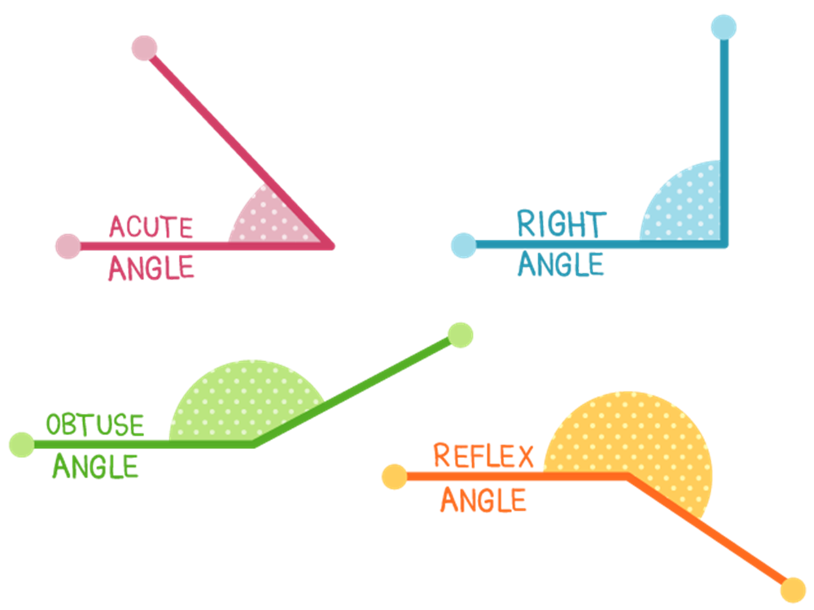
This function calculates in the following steps
Step 0: calculates the unit vectors for incoming and outgoing vectors
Step 1: takes the dot product to see if they are facing same way
Step 2: check for weird situations: parallel in same direction, opposite but entering same point, spin in different directions around circle, etc.
Step 3: use cross product to determine the “reflex angle” for situations larger than 180 degrees.
Step 4: confirm that apex angle is within same sector

Slide 24
Another means of finding angles in the arc is to specify 2 points AND the cross-product direction from start to finish. The function that does this is: fcn_geometry_findAngleUsing2PointsOnCircle
Counterclockwise is positive, clockwise is negative
%% BASIC example for one circle, incoming and outgoing are 90 degrees
fig_num = 1;
centers = [0 0];
radii = [1];
start_angles = [45]*pi/180;
start_points_on_circle = [radii.*cos(start_angles) radii.*sin(start_angles)];
end_angles = [-45]*pi/180;
end_points_on_circle = [radii.*cos(end_angles) radii.*sin(end_angles)];
cross_products = [1];
true_angle = start_angles - end_angles;
[angles] = fcn_geometry_findAngleUsing2PointsOnCircle(...
centers,...
radii,...
start_points_on_circle,...
end_points_on_circle,...
cross_products,...
fig_num);
fcn_summarize(angles,...
true_angle,...
centers,...
radii,...
start_points_on_circle,...
end_points_on_circle,...
cross_products);

Slide 25
Note: these functions support vectorization
%% ADVANCED example - vectorized
fig_num = 100;
centers = [0 0; 4 4; 8 10; -6 10];
radii = [1; 2; 4; 3];
start_angles = [90; 0; -90; 45]*pi/180;
start_points_on_circle = [radii.*cos(start_angles) radii.*sin(start_angles)]+centers;
end_angles = [45; 135; 180; 0]*pi/180;
end_points_on_circle = [radii.*cos(end_angles) radii.*sin(end_angles)]+centers;
cross_products = [-1; 1; -1; 1];
true_angle = start_angles - end_angles;
[angles] = fcn_geometry_findAngleUsing2PointsOnCircle(...
centers,...
radii,...
start_points_on_circle,...
end_points_on_circle,...
cross_products,...
fig_num);
fcn_summarize(angles,...
true_angle,...
centers,...
radii,...
start_points_on_circle,...
end_points_on_circle,...
cross_products);

Slide 26
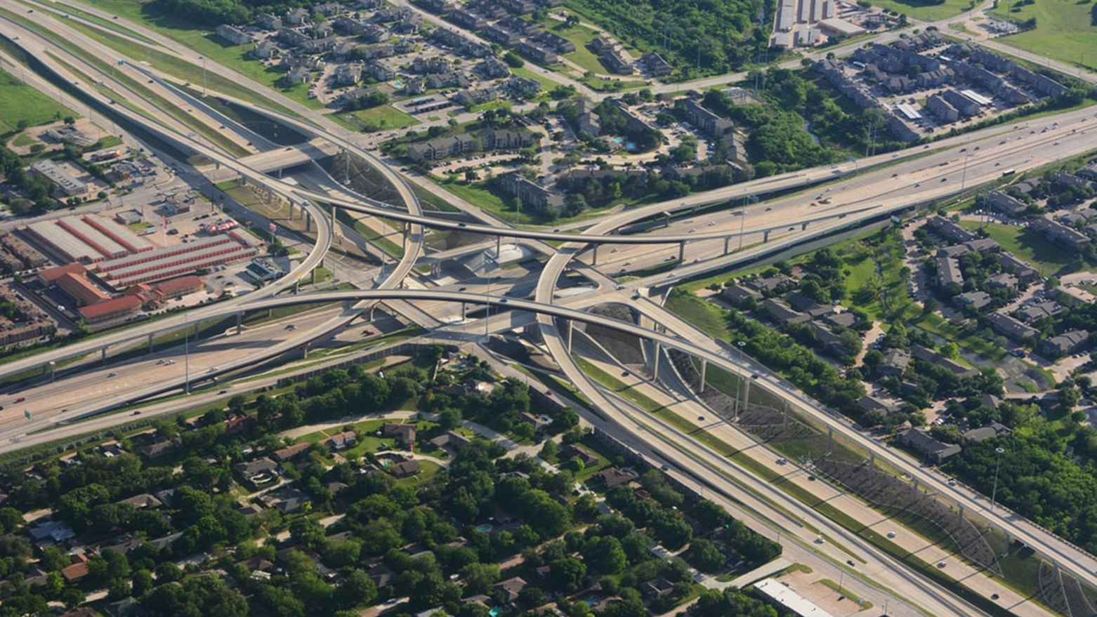
For many paths, entry into a curve at speed requires calculations of tangents into circles

Slide 27
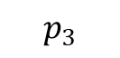
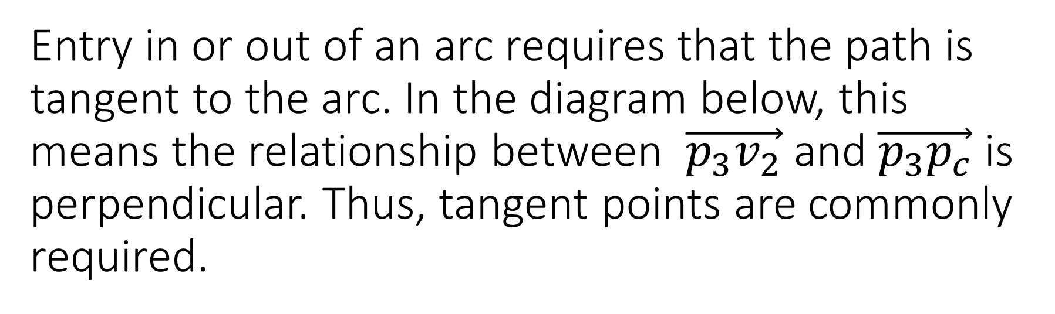
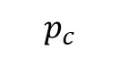

Entry in or out of an arc requires that the path is tangent to the arc. In the diagram below, this means the relationship between $\vec{p_{3}v_{2}}$ and $\vec{p_{3}p_{c}}$ is perpendicular. Thus, tangent points are commonly required.
$$p_{3}$$
$$p_{c}$$
$$v_{2}$$

Slide 28
The tangents from a circle to a point (2 for each point) can be calculated from: fcn_geometry_findTangentPointsFromPointToCircle
%% ADVANCED example that uses vectors of centers and points
fig_num = 2;
centers = [0 0; 1 4];
radii = [1; 1];
points = [2 3; 3 4];
points_tangent = fcn_geometry_findTangentPointsFromPointToCircle(...
centers,radii,points,fig_num);

Slide 29
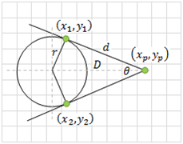
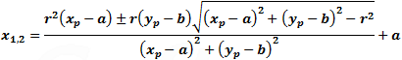
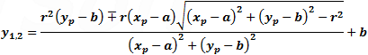
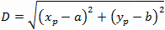
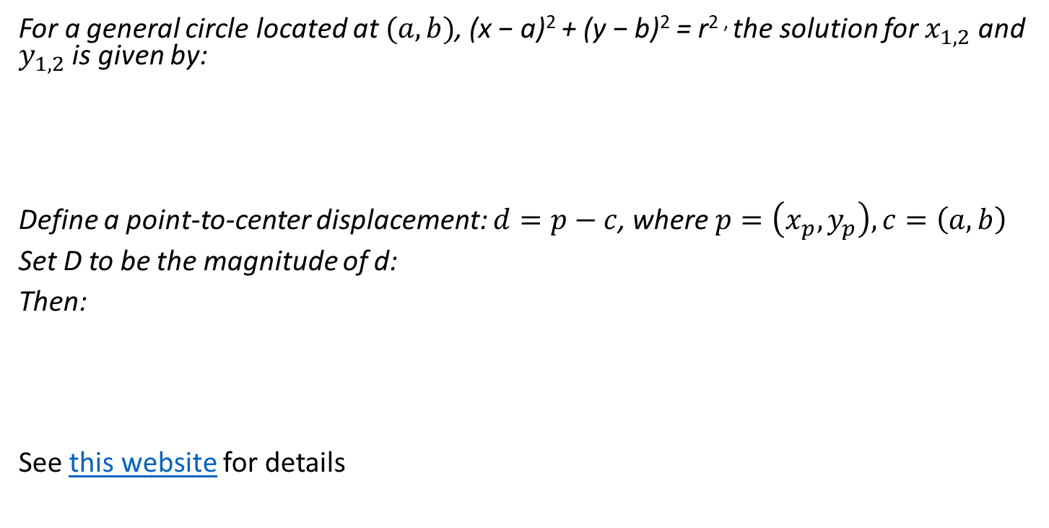


This function calculates the tangent points on a circle from a point
For a general circle located at $(a,b)$, (x − a)² + (y − b)² = r^{2 ,} the solution for $x_{1,2}$ and $y_{1,2}$ is given by:
Define a point-to-center displacement: $d=p−c$, where $p=\left(x_{p},y_{p}\right), c=\left(a,b\right)$
Set D to be the magnitude of d:
Then:
See this website for details
$$x_{1,2}=\frac{r^{2}⋅d_{x}±r⋅d_{y}⋅\sqrt{D^{2}−r^{2}}}{D^{2}}+a$$
$$y_{1,2}=\frac{r^{2}⋅d_{y}∓r⋅d_{x}⋅\sqrt{D^{2}−r^{2}}}{D^{2}}+b$$

Slide 30


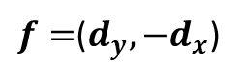

These calculations can be vectorized
From:
Then the tangent points are:
Where:
And d and c are defined as before, but vectorized into matrices of [x, y], where x and y are columns.
$$x_{1,2}=\frac{r^{2}⋅d_{x}±r⋅d_{y}⋅\sqrt{D^{2}−r^{2}}}{D^{2}}+a$$
$$y_{1,2}=\frac{r^{2}⋅d_{y}∓r⋅d_{x}⋅\sqrt{D^{2}−r^{2}}}{D^{2}}+b$$
$$t_{1,2}=\frac{r^{2}⋅d±r⋅f⋅\sqrt{D^{2}−r^{2}}}{D^{2}}+c$$
$f=$($d_{y},−d_{x}$)

Slide 31
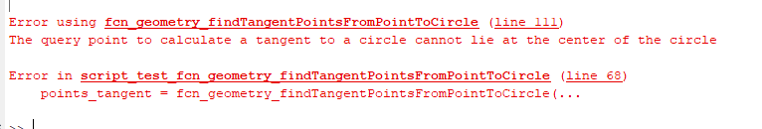
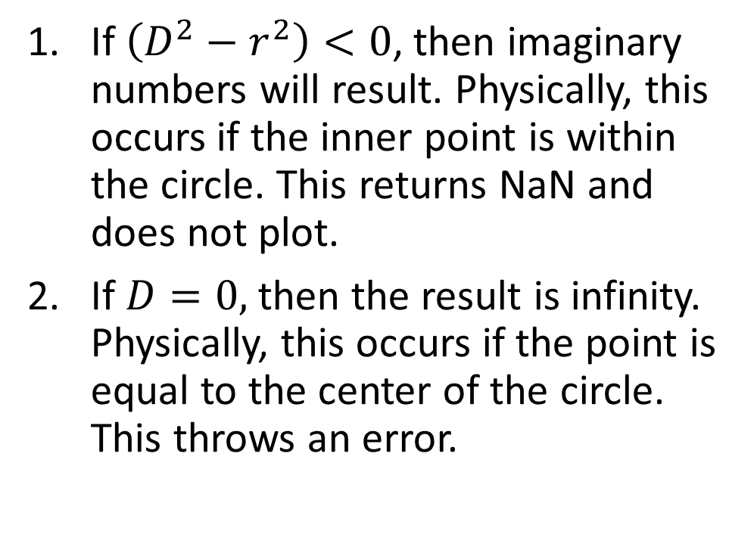
There are two conditions that cause this algorithm for inner tangents to fail
If $\left(D^{2}−r^{2}\right)<0$, then imaginary numbers will result. Physically, this occurs if the inner point is within the circle. This returns NaN and does not plot.
If $D=0,$ then the result is infinity. Physically, this occurs if the point is equal to the center of the circle. This throws an error.
%% ADVANCED example that has one point too close to the center
fig_num = 2;
centers = [0 0; 1 4];
radii = [1; 1];
points = [0.5 0.5; 3 4];
points_tangent = fcn_geometry_findTangentPointsFromPointToCircle(...
centers,radii,points,fig_num);
%% ADVANCED example that has one point on the center
fig_num = 2;
centers = [0 0; 1 4];
radii = [1; 1];
points = [1 1; 1 4];
points_tangent = fcn_geometry_findTangentPointsFromPointToCircle(...
centers,radii,points,fig_num);

Slide 32
If a single point is needed, then the cross-product can be used with fcn_geometry_findTangentPointFromPointToCircle
The function will return only the ONE tangent point where the vector from the external point to the circle tangent, crossed toward the center of the circle, has the same cross-product sign as given by the inputs.
%% BASIC example for one circle and one point (positive cross product)
fig_num = 1;
centers = [0 0];
radii = 1;
points = [2 3];
cross_prod = 1; % Keep the postive cross product
points_tangent = fcn_geometry_findTangentPointFromPointToCircle(...
centers,radii,points,cross_prod,fig_num); %#ok<*NASGU>

Slide 33
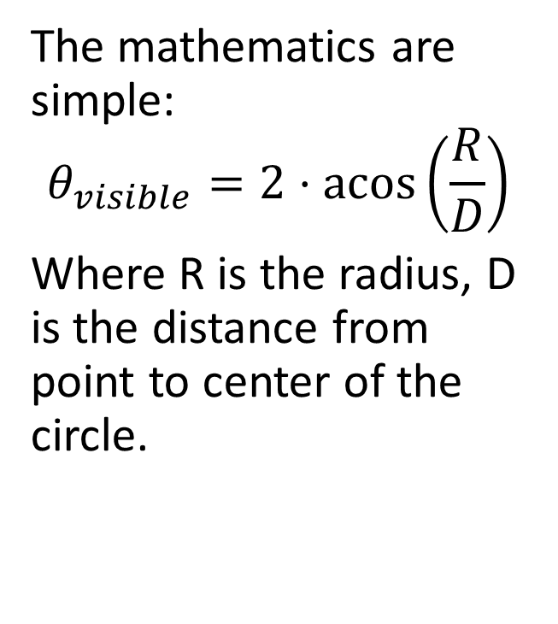
A common calculation is the amount of arc visible on a circle, from a point outside the circle
The mathematics are simple:
$$θ_{visible}=2⋅\operatorname{acos}\left(\frac{R}{D}\right)$$
Where R is the radius, D is the distance from point to center of the circle.

Slide 34
This is solved in the following function: fcn_geometry_findVisibleArcsFromPoints.m
%% BASIC example for one circle and one point
fig_num = 1;
centers = [0 0];
radii = 1;
points = [2 3];
visible_arc_angles = fcn_geometry_findVisibleArcsFromPoints(...
centers,radii,points,fig_num);

Slide 35
This function is vectorized
%% ADVANCED example that uses vectors of centers and points
fig_num = 2;
centers = [0 0; 1 4];
radii = [1; 1];
points = [2 3; 3 4];
visible_arc_angles = fcn_geometry_findVisibleArcsFromPoints(...
centers,radii,points,fig_num);

Slide 36
If a point is inside the circle, NaN is returned
%% ADVANCED example that has one point too close to the center
fig_num = 3;
centers = [0 0; 1 4];
radii = [1; 1];
points = [0.5 0.5; 3 4];
visible_arc_angles = fcn_geometry_findVisibleArcsFromPoints(...
centers,radii,points,fig_num);

Slide 37
If a query point is in the middle of the circle, this results in division by zero and gives an error
%% ADVANCED example that has one point on the center
fig_num = 2;
centers = [0 0; 1 4];
radii = [1; 1];
points = [1 1; 1 4];
visible_arc_angles = fcn_geometry_findVisibleArcsFromPoints(...
centers,radii,points,fig_num);
Error using fcn_geometry_findVisibleArcsFromPoints (line 102)
The query point to calculate a tangent to a circle cannot lie at the center of the same circle
Error in script_test_fcn_geometry_findVisibleArcsFromPoints (line 90)
visible_arc_angles = fcn_geometry_findVisibleArcsFromPoints(...

Slide 38
The tangent point or points functions are also used in the calculation of tangents to circles
fcn_geometry_findTangentPointTwoCircles – calculates only the tangent points that meet the cross-product criteria. This one is more efficient and should be used if possible.
fcn_geometry_findTangentPointsTwoCircles – calculates all the tangent points but allows options to force inner or outer tangents, as well as voting points, to produce results similar to the above. Voting does not always work, so cross product specification (via other function) is preferred.

Slide 39
The cross-product inputs are used to define which tangent to use
Positive-to-negative cross product from start-to-end Negative-to-positive cross-product
%% BASIC example - find the points for two circle, all inner
fig_num = 1;
centers_start = [1 1];
centers_end = [3 1];
radii_start = [0.5];
radii_end = [0.3];
cross_products_start = [1];
cross_products_end = [-1];
[...
points_tangent_start, ...
points_tangent_end] ...
= ...
fcn_geometry_findTangentPointTwoCircles(...
centers_start,...
centers_end,...
radii_start,...
radii_end,...
cross_products_start,...
cross_products_end,...
fig_num);
%% BASIC example - find the points for two circle, all inner, opposite cross
fig_num = 2;
centers_start = [1 1];
centers_end = [3 1];
radii_start = [0.5];
radii_end = [0.3];
cross_products_start = [-1];
cross_products_end = [1];
[...
points_tangent_start, ...
points_tangent_end] ...
= ...
fcn_geometry_findTangentPointTwoCircles(...
centers_start,...
centers_end,...
radii_start,...
radii_end,...
cross_products_start,...
cross_products_end,...
fig_num);

Slide 40
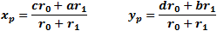
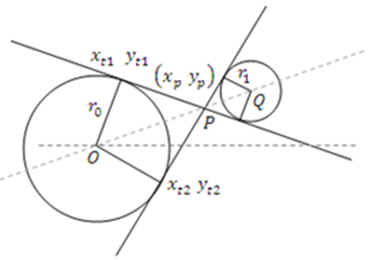
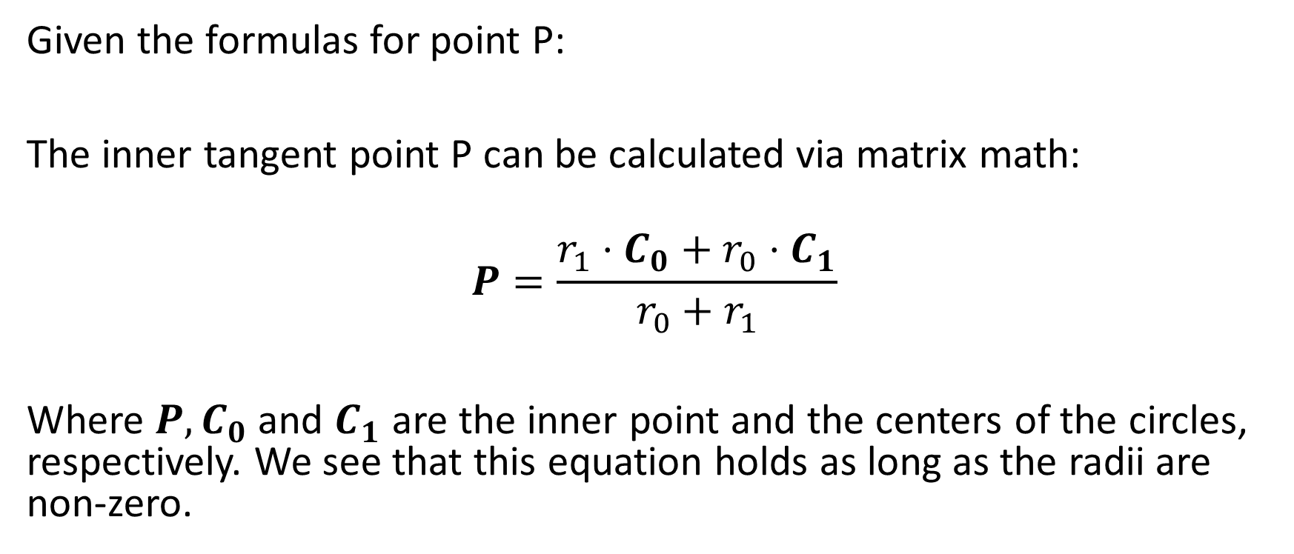
The inner tangents are determined by finding the inner point where inner tangents cross, then using the tangent point operation thereafter.
Given the formulas for point P:
The inner tangent point P can be calculated via matrix math:
$$P=\frac{r_{1}⋅C_{0}+r_{0}⋅C_{1}}{r_{0}+r_{1}}$$
Where $P, C_{0}$ and $C_{1}$ are the inner point and the centers of the circles, respectively. We see that this equation holds as long as the radii are non-zero.
See: http://www.ambrsoft.com/TrigoCalc/Circles2/Circles2Tangent_.htm

Slide 41

The inner tangent calculation fails when the circles are too close to each other
In particular, it will fail if $D < r0 + r1$, where D is the distance between centers.
%% FAIL CASE example -
% find the points for two circles, unequal radii, inner, circles too
% close together (criteria is that r1+r2 <= D, where D is distance
% between centers)
fig_num = 92;
centers_start = [1 1];
centers_end = [3 1];
radii_start = [1];
radii_end = [1.1];
cross_products_start = [1];
cross_products_end = [-1];
[...
points_tangent_start, ...
points_tangent_end] ...
= ...
fcn_geometry_findTangentPointTwoCircles(...
centers_start,...
centers_end,...
radii_start,...
radii_end,...
cross_products_start,...
cross_products_end,...
fig_num)

Slide 42
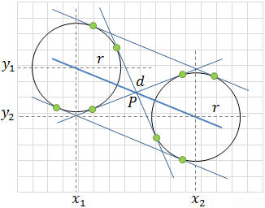
If the circles have the same radii, then the angle between the centers of the circles is used to calculate the outer tangent points for both circles
Positive cross product
Negative cross product
x_{1,2} = x₁ ± r sinθ | y_{1,2} = y₁ ∓ r cosθ
x_{3,4} = x₂ ± r sinθ | y_{3,4} = y₂ ∓ r cosθ
See: script_test_fcn_geometry_findTangentPointTwoCircles.m

Slide 43
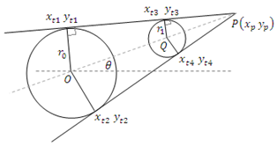
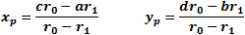

When circles have different radii, an external point is calculated
The outer tangent point, P, is given by:
Which can be written as:
$$P=\frac{r_{0}⋅C_{1}−r_{1}⋅C_{0}}{r_{0}−r_{1}}$$

Slide 44

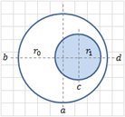
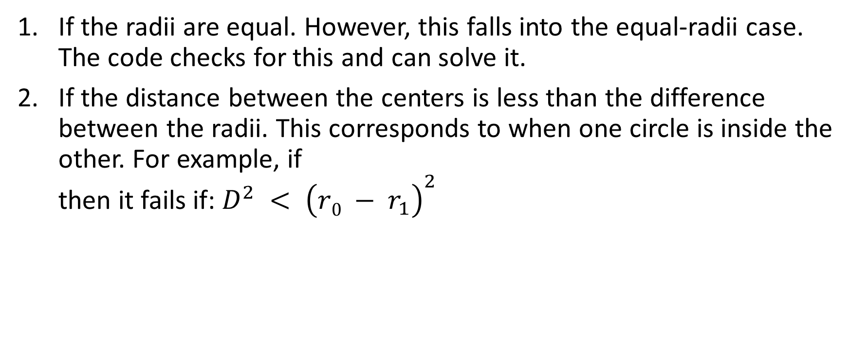
There are two conditions where the calculation of outer tangents can fail
If the radii are equal. However, this falls into the equal-radii case. The code checks for this and can solve it.
If the distance between the centers is less than the difference between the radii. This corresponds to when one circle is inside the other. For example, if then it fails if: $D^{2} < {\left(r0 − r_{1}\right)}^{2}$

